Slide 1

CEIS310
Process improvements
Final Project
Pierre Liron
Dec 17, 2022

Slide 2
Points Allocation for Final Project
Item | Points
Identify necessary process to establish improvements. | 15
Demonstrate data preparation using normalization. | 20
Demonstrate communication skills in various environments and contexts. | 25
Test/Train system utilizing Linear Regression. | 25
Build an Evaluate Model with all ML metrics. | 25
Implement Score Model for the experiment. | 20
Test a system utilizing RSS Computation. | 20
Total | 150

Slide 3
Introduction
In this course, the two main processes of six sigma will be introduced - DMAIC (define, measure, analyze, improve, control) and DMADV (define, measure, analyze, design, verify). Students will learn how these principles are applied to improve existing processes and create new ones. Emphasis will be placed on DMAIC and statistical process and product control. General statistic principles will be reviewed and new topics addressing principles of statistical process control will be covered. Material covered represents competencies and proficiencies aligned to Lean Six Sigma Yellow Belt certification.
Machine Learning for process improvement in Python, through a Spyder Environment.

Slide 4
Inventory
Install Anaconda3 to be able to use Spyder (Python) or use Virtual Machine Azure Lab
Different types of data base and related quote

Slide 5
Introduction To Machine Learning
In machine learning, one of the first tasks that you need to perform is data cleansing of the available data sets. It requires examining the data carefully for any missing values, replacing with some valid values, and normalizing the data, just to name a few. Accessing the different data sets will be covered in subsequent module.
Many machine learning algorithms make assumptions about your data. Therefore it is a good idea to prepare your data in such a way to best expose the structure of the problem to the machine learning algorithms that you intend to use.

Slide 6
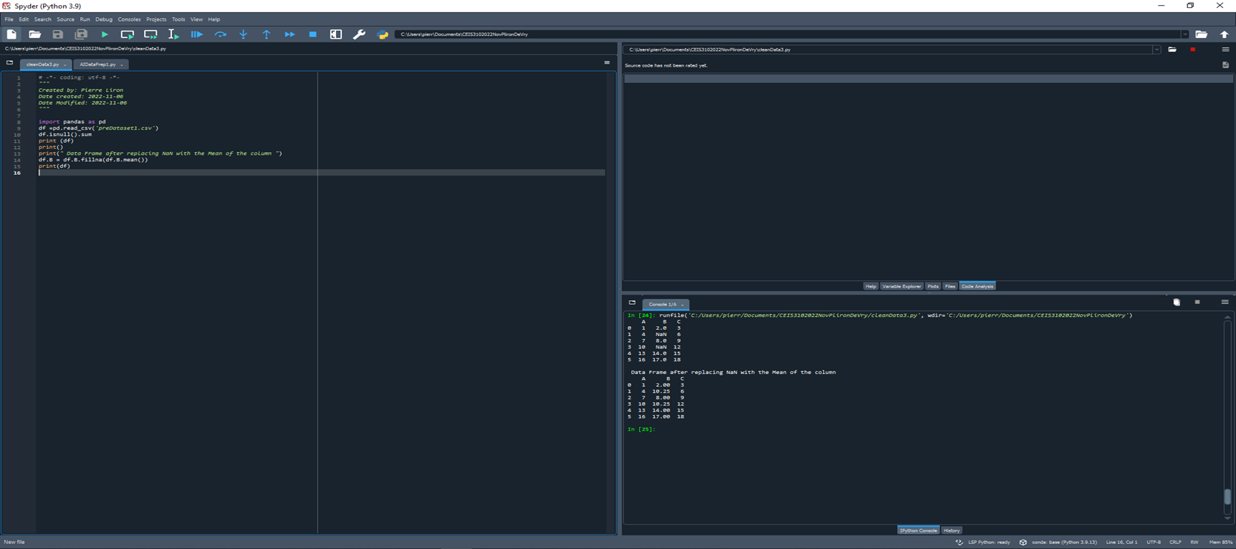
Design and Uploaded Dataset

Slide 7
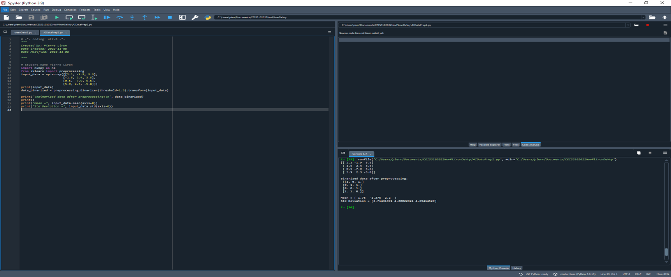
Data Preparation (Cleansing/Normalization)

Slide 8
Accessing and Exploring Machine Learning Datasets and Generating Your Own Dataset
To bring awareness, instigate interest, and promote the need of using AI and machine learning algorithms and tools for process improvement. To keep things simple, we will only focus on use of Python machine learning library for regression analysis and simple test/train techniques.

Slide 9
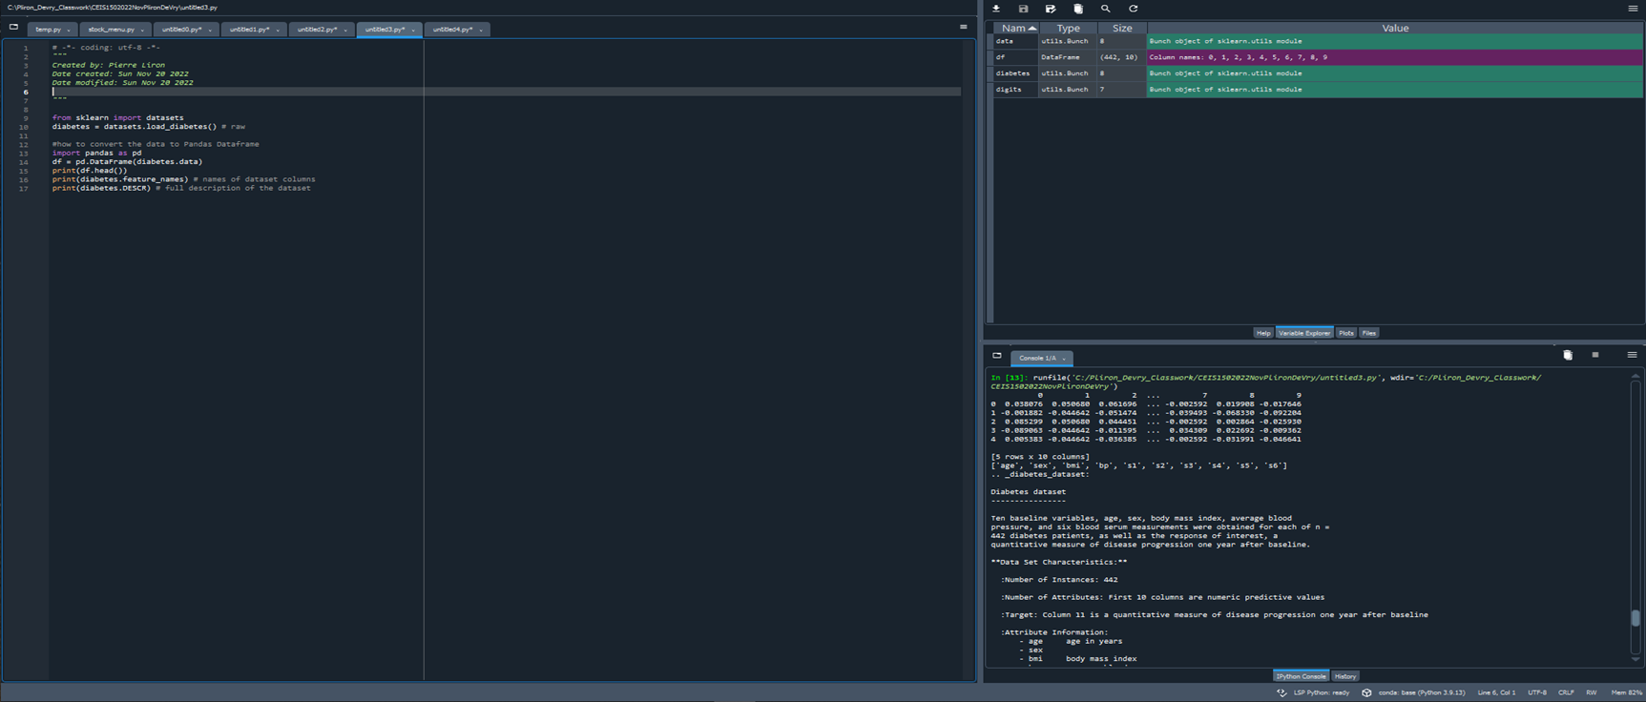
Selecting Features

Slide 10
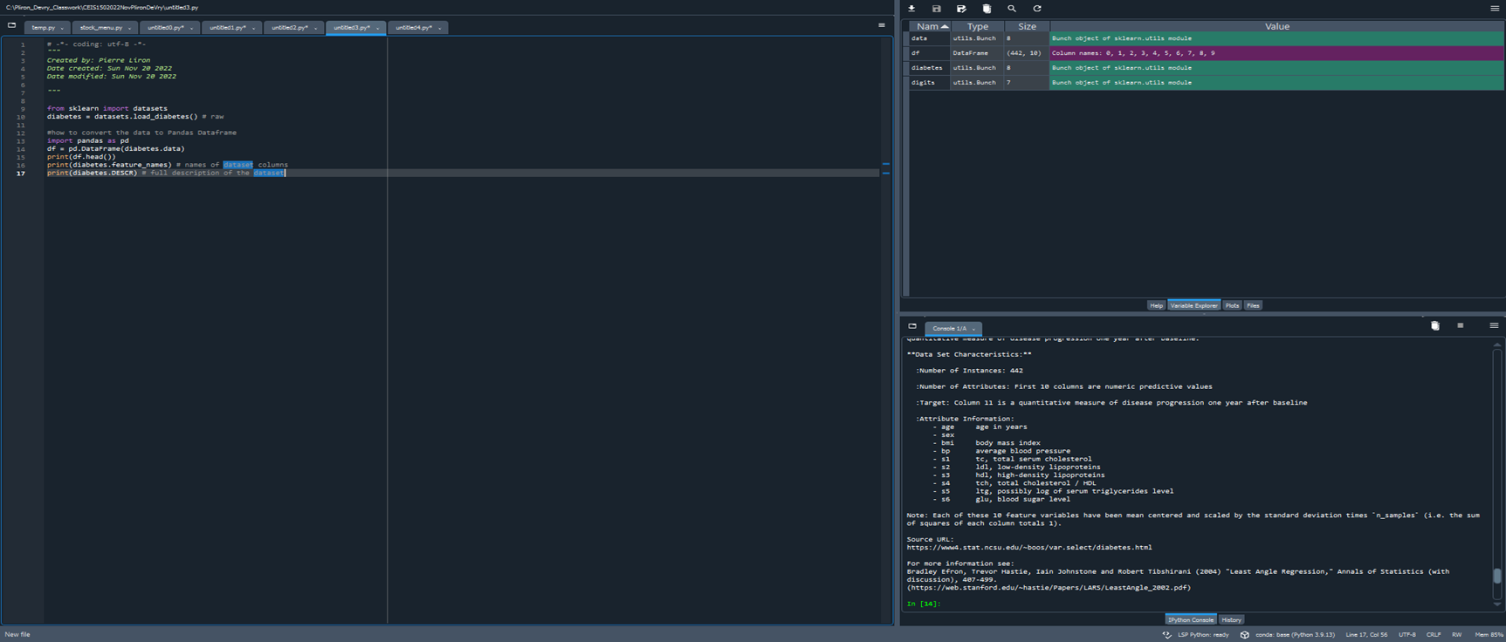
Selecting Features

Slide 11
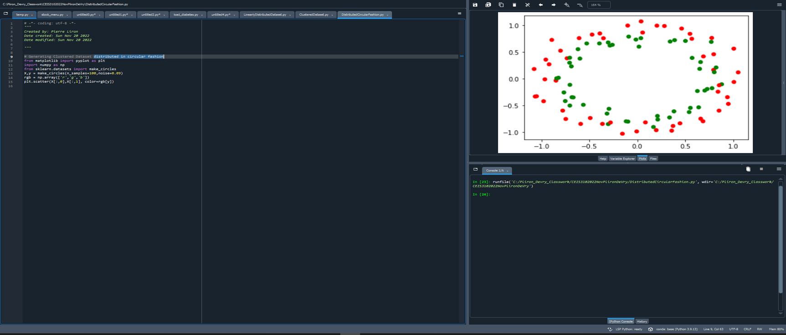
Linear Regression or Poly Regression ML Tools for Prediction

Slide 12
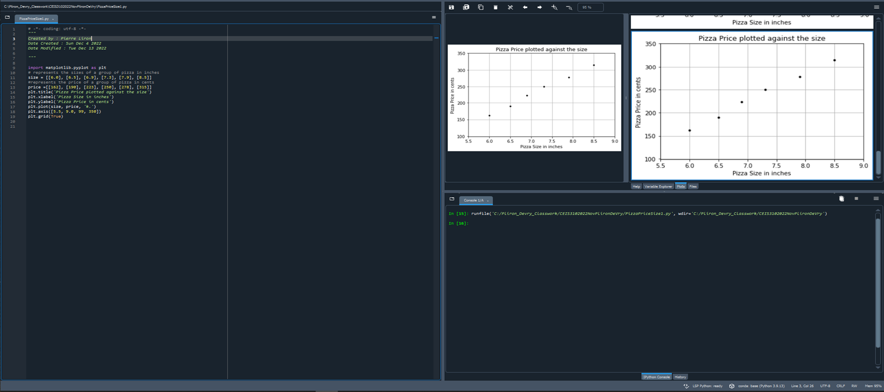
Training the Model

Slide 13
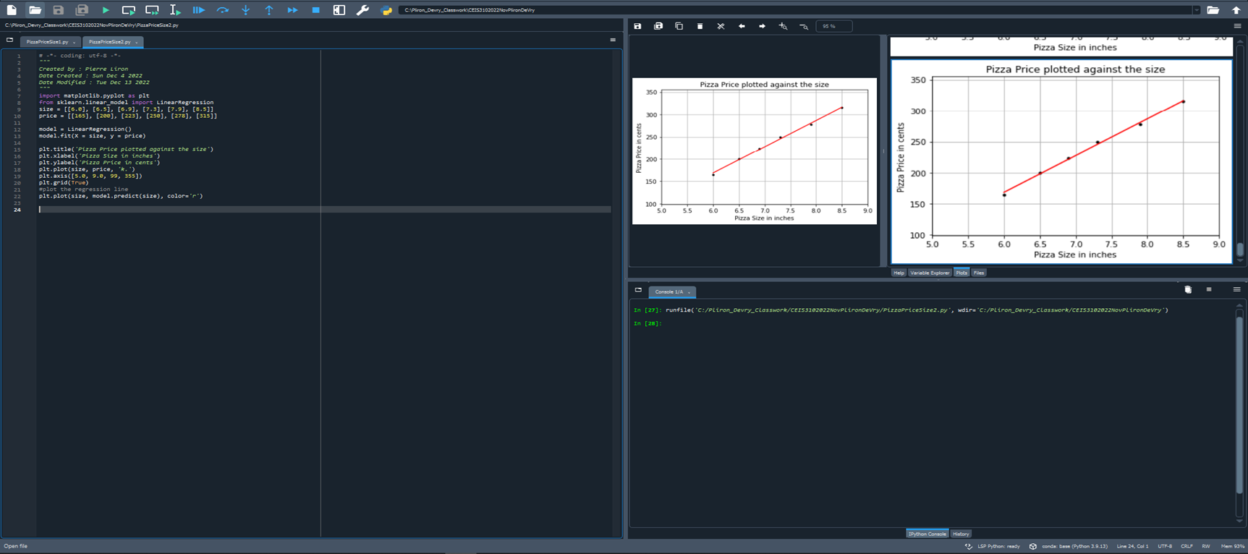
Train/Test Split

Slide 14
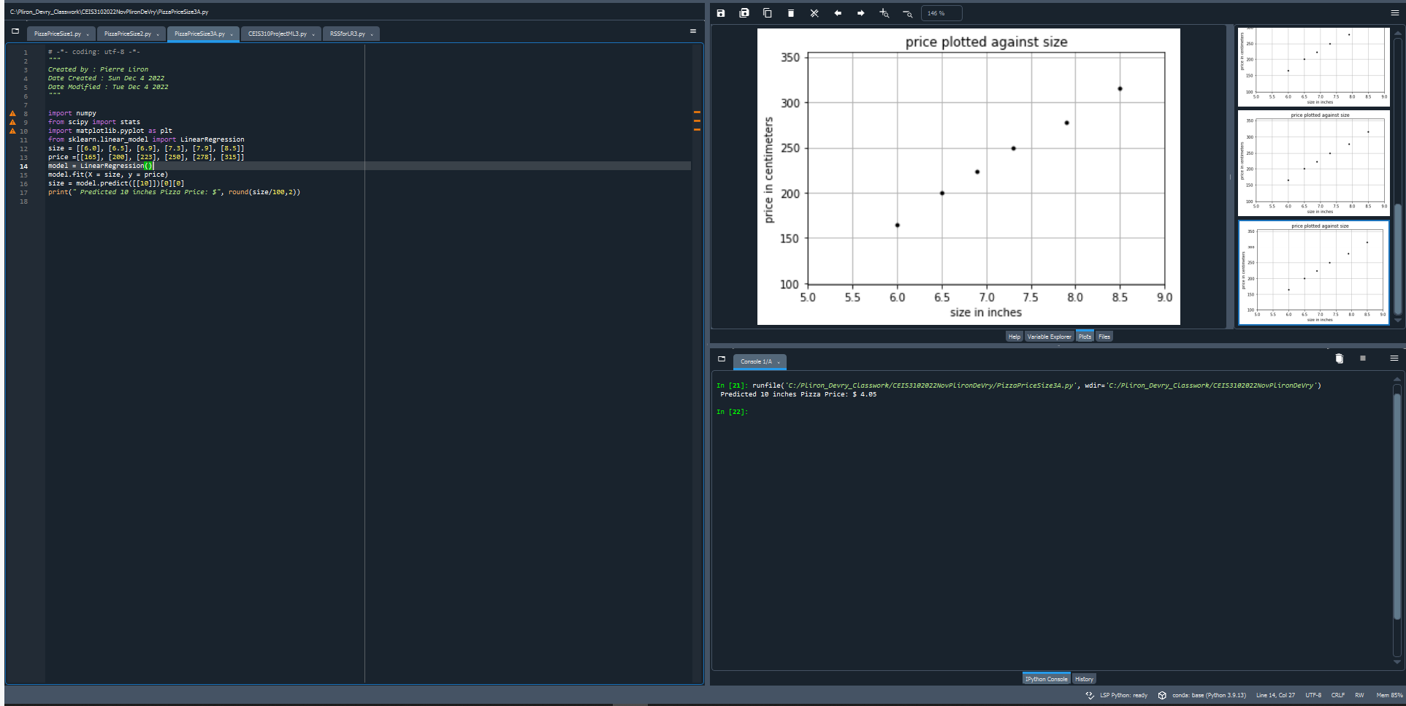
Examining the Model, Computing RSS

Slide 15
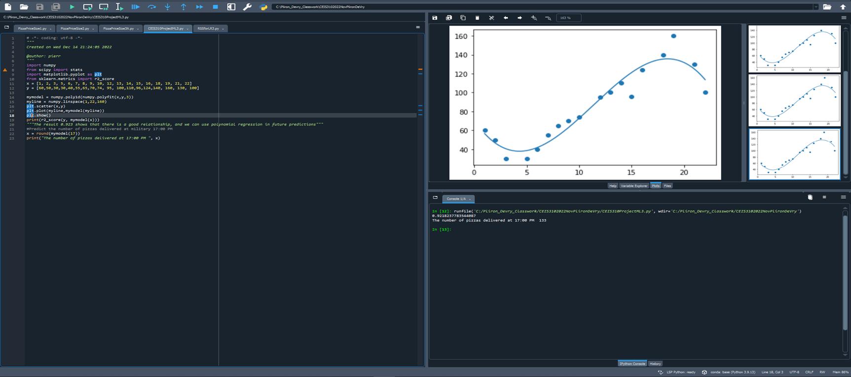
Scoring the Model – r2-Score

Slide 16
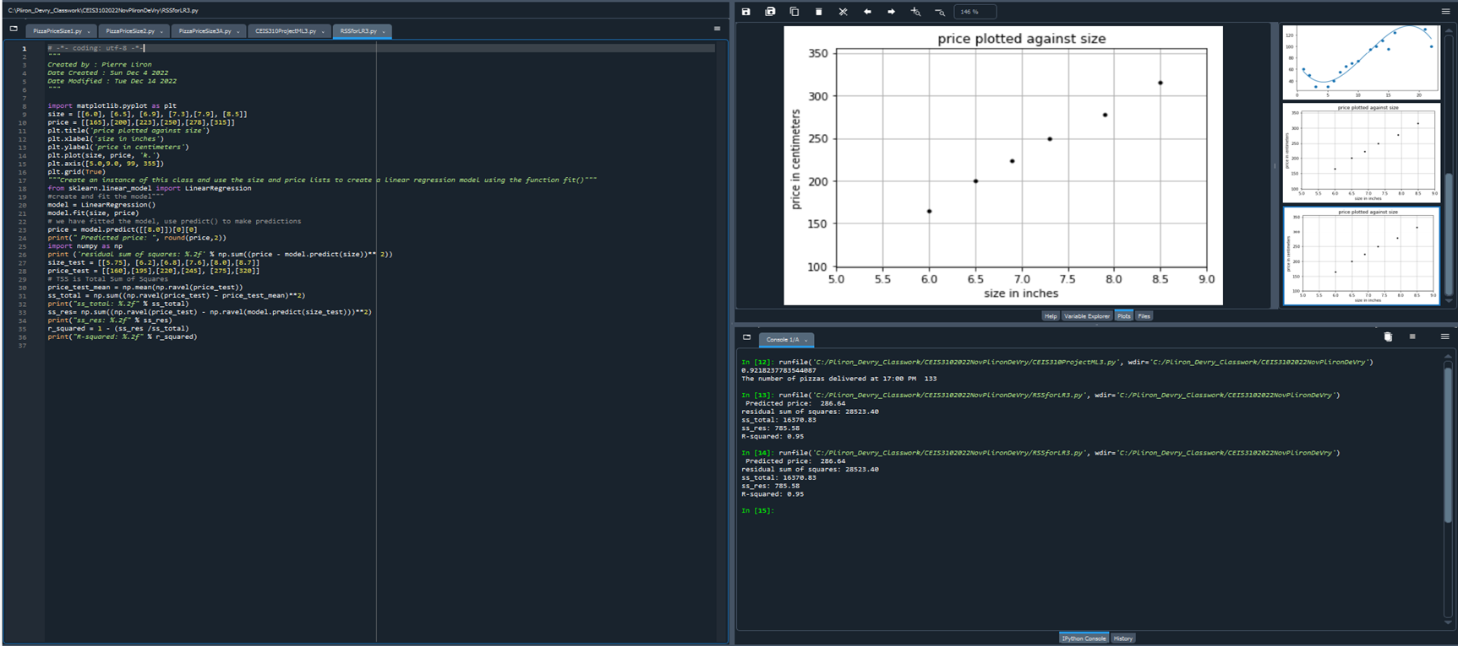
Evaluating the Model Using Test Data Set

Slide 17
Conclusion
This project exposed me to utilizing machine learning to automate the process improvement.
I utilized various data base, libraries to accomplish these tasks.

Slide 18
Challenges
Code debug and troubleshooting. I was missing a close parentheses that caused me a “SyntaxError: invalid syntax” on the following line. I did research on the error and found no solution. The last thing I did was use a different IDE and it underlined the error. I was able to fix and get the output I was expecting.
I accidentally removed all Help, Variable Explorer, Plots and Files feature in Spyder, I had to figure how to get that back

Slide 19
Career Skills Obtained
Learning the six sigma concepts
Using Python to automate process improvement tasks
Coding and Machine learning experience
Process improvement skills

